Slide 1

Object-Oriented Programming Discussion, Lecture, & Lab Eric Pogue
Agenda for Thursday, January 16th at 2pm CT:
Assignment
Friendly Conversation Topic
Scrum Roles, Rituals, and Artifacts
Introductions*
Course Overview
Review Course Syllabus
Assignments for Next Class
Preview Week 1 / Sprint 1 Activities & Assignments
Lab… starting no later than 2:45pm CT
Discussion & Questions welcome at any time… please be present with no phones or email during our time together

Slide 2
Assignment for Today
Complete Activity List items through item 8 before our next class and be prepared to discuss them
Take your name tags with you and bring them back to class through the end of Sprint 2

Slide 3
Friendly Conversation Topic – The Agile Manifesto

Slide 4
Agile Manifesto
“We are uncovering better ways of developing software by doing it and helping others do it. Through this work we have come to value:
Individuals and interactions over processes and tools
Working software over comprehensive documentation
Customer collaboration over contract negotiation
Responding to change over following a plan
That is, while there is value in the items on the right, we value the items on the left more.”
Notes:
This was kind of “hippy-ish” and egalitarian in its day… quite controversial in its day
“Everyone is a team member and is responsible for the work getting done”… we don’t need no titles or positions… self-organizing… we will make our own commitments… transparency (let’s share the information)… flexible/organic teams, organic architecture (minimal documentation/standards)… no contracts (let’s talk it over)
The flip side:
We will actively and voluntarily play important roles on our team
The rules (rituals) that we do have… we WILL follow
We will create, demo, and release working software/products
We will utilize practical processes, tools, documentation, and planning
When we make commitments, we will live up to those commitments… as a team (“No winners on a losing team, and no losers on a winning team”)
We will be responsive and continuously improve (Retrospectives)
We will be transparent with how WE work and share our information

Slide 5
Agile Manifesto
Agile Team Commitments:
Everyone is a team member and is responsible for getting the work done (we don’t need titles and positions)
We will actively and voluntarily play important roles on our team
The rules (rituals) that we do have… we WILL follow
We will create, demo, and release working software products
We will utilize practical processes, tools, documentation, and planning
When we make commitments, we will live up to those commitments… as a team (“No winners on a losing team, and no losers on a winning team”)
We will be responsive and continuously improve (Retrospectives)
We will be transparent with how WE work and share our information
Notes:
Agile Team Commitments
Everyone is a team member and is responsible for the work getting done
we don’t need no titles or positions
self-organizing
we will make our own commitments
transparency (let’s share the information)
flexible/organic teams, organic architecture (minimal appropriate documentation/standards)
no contracts (let’s talk it over)

Slide 6
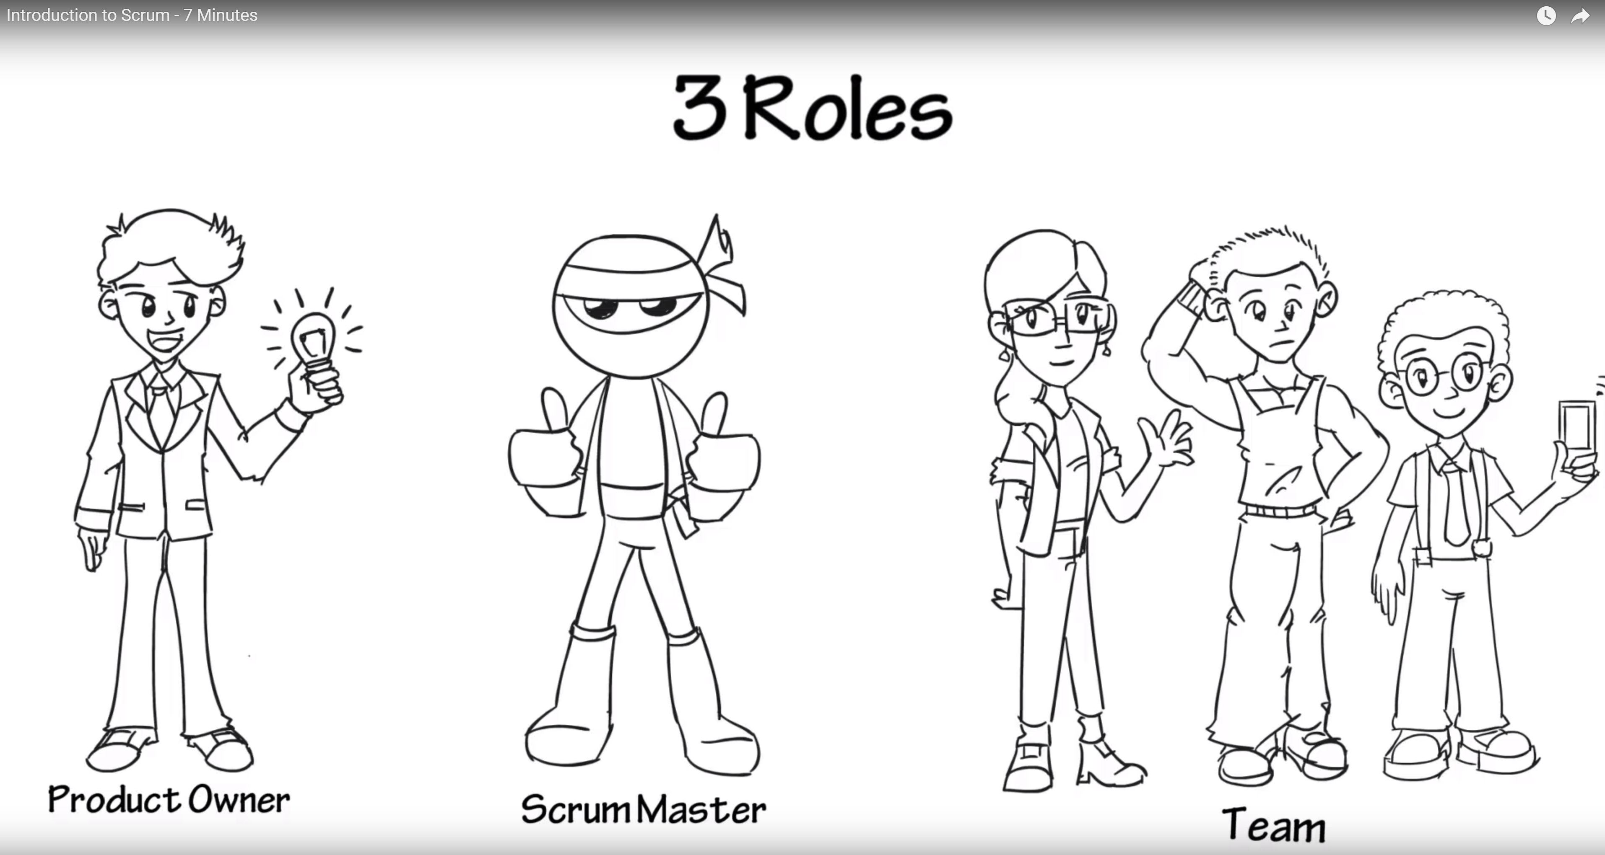
Scrum Discussion from Introduction to Scrum - 7 Minutes YouTube video [link]
Notes:
Other roles exist like developer, tester, etc.
Individuals are expected to play multiple roles as needed.
Three Artifacts:
Product Backlog
User Stories
Burndown Chart
Three Rituals:
Sprint Planning
Daily Scrum
Sprint Review or Retrospective

Slide 7
Scrum Roles, Rituals, and Artifacts
Three Roles:
Product Owner
Scrum Master
Team Member
Three Rituals:
Sprint Planning
Daily Scrum
Sprint Review or Retrospective
Three Artifacts:
Product Backlog
User Stories
Burndown Chart

Slide 8
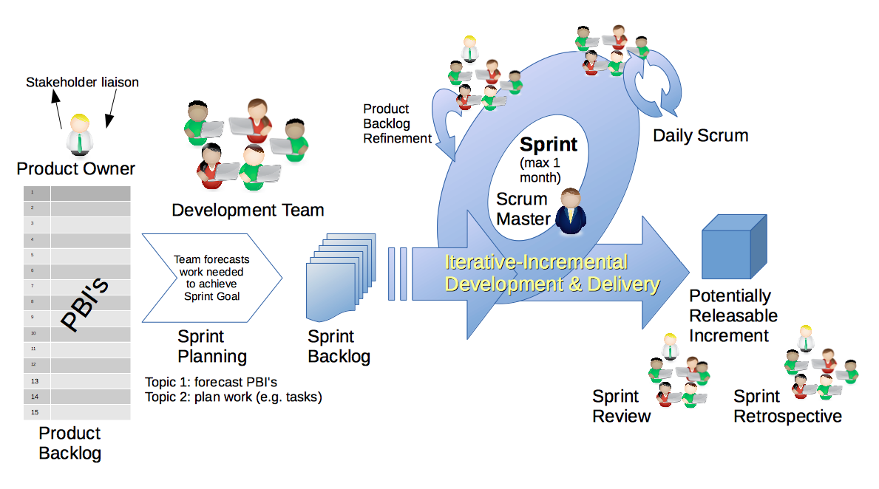
Scrum Process & Roles – Sprint Planning
By Dr ian mitchell - Own work, CC BY-SA 4.0, Link

Slide 9
Assignment for Next Class
Complete Activity List items through item 12 before our next class and be prepared to discuss them
Take your name tags with you and bring them back to class through the end of Sprint 2

Slide 10
Lab
As A Scrum Team:
Results of last Office 365 challenge
Identify today’s OOP topic speaker for the day (not the scrum master)
Review the “Big Three” Object-Oriented Concepts
Answer the question, “What is the difference between Implementation Inheritance and Interface Inheritance?”
Analyze Programming Assignment 1, Quiz 1, and Discussion Board 1 and document any questions
Complete Discussion Board 1
Complete you first attempt at Quiz 1... you can take it again later
Team Report Out Guidelines
Scrum Master will stand up, give your name, your team name, and briefly answer the following questions:
What did you accomplish since the last meeting? And what will you be working on until the next meeting?
Is the team committed to completing assignments? All/Most/Some
What is getting in your way or keeping you from completing the assignments?

Slide 11
Results from: Any Volunteers to try to set up GitHub using Office 365 Login Credentials? … stop up after class.

Slide 12
Wrap-up and Final Questions/Comments

Slide 13
End of Session

Slide 14
Object-Oriented Programming Discussion, Lecture, & Lab Eric Pogue
Agenda for Thursday, January 16th from 2 to 3:15pm CT:
Friendly Conversation Topic
Review Assignment from Last Class
Sprint Planning
Assignment for Next Class
Lab
Wrap-up and Final Questions/Comments
Discussion & Questions welcome at any time… please be present with no phones or email during our time together

Slide 15
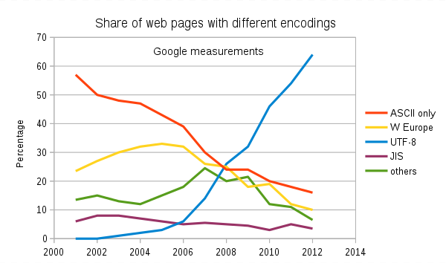
Text File Encoding Standards
ASCII
Unicode
UTF-8
Others

Slide 16
ASCII
Notes:
All files are binary files some binary files can be interpreted as text files
Some text files are ASCII and some text files are UTF-8
All ASCII files are valid UTF-8
Consider quote vs. curly quote in ASCII vs UTF-8

Slide 17
Text File End-Of-Line (EOL) and Encoding
Industry adoption of end-of-line encoding includes:
Windows: Both Carriage Return (CR, \r, 0x0d) and Line Feed (LF, \n, 0x0a) together.
Unix/Linux/OSX: Just Line Feed (LF, \n, 0x0a)
Mac (pre-OSX): Just Carriage Return (CR, \r, 0x0d)
Article on Windows Notepad supporting non-Windows EOF conventions [link]

Slide 18
Source Code Indenting and Tabs vs Spaces
Source code should be indented consistently in order to promote readability.
Tabs versus Spaces has been a holy war among programmers since source files were created:
“Should source-code lines be indented using tab characters or space characters? … and if spaces, how many spaces?” [link]
Rules:
Be consistent with yourself
Be consistent with your project… and fellow developers on the project
Be consistent with your organization
For this class, please use four spaces and never utilize tabs.

Slide 19
Q&A: Syllabus Overview

Slide 20
Q&A: Programming Assignment 1

Slide 21
Q&A: Quiz 1

Slide 22
Lab
As A Scrum Team:
Discuss the assignment for next class
Identify two team members (not the Scrum Master) who will each lead the discussion of a OOP Concept starting at 2:34pm
Discuss “Object-Oriented Programming Concepts & Practices”
Team report-out by Scrum Master 2:48
Team Report-out Guidelines
Scrum Master stand up, give your name, your team name, and briefly answer the following questions:
What did you accomplish since the last meeting?
What will you working on until the next meeting?
Is the team committed to completing assignments? All/Most/Some
What is getting in your way or keeping you from completing the assignments?

Slide 23
Lab
As A Scrum Team:
Continue: Identify two team members (not the Scrum Master) who will each lead the discussion of an OOP Concept
Discuss Programming Assignment 1 and Quiz 1 in detail
Demo Activities List items 9 and 10 to your Scrum Master
Complete initial DB1 post
Work on Programming Assignment 1
Team report out by Scrum Master 2:48
Team Report Out Guidelines
Scrum Master stand up, give your name, your team name, and briefly answer the following questions:
What did you accomplish since the last meeting? And what will you be working on until the next meeting?
Is the team committed to completing assignments? All/Most/Some
What is getting in your way or keeping you from completing the assignments?

Slide 24
Object-Oriented Programming Discussion, Lecture, & Lab Eric Pogue
Agenda for Wednesday, September 4th from 2 to 2:50pm CST:
Review Assignment from Last Class
Friendly Conversation Topic – Source Code Snippets in VS Code
Q&A: Object-Oriented Programming Concepts and Practices
Q&A: OOP Patterns
Discussion: Git & GitHub
Assignment for Next Class
Lab
Discussion & Questions welcome at any time… please be present with no phones or email during our time together

Slide 25
Friendly Conversation Topic – Source Code Snippets in VS Code

Slide 26
Assignment for Next Class
Complete all items on the sprint 1 Activities List with the possible exceptions of Programming Assignment 1 and Quiz 1. You should have a solid start on both items, but It is okay if you need to spend some time over the weekend to complete them.
Be ready to Discuss OOP Patterns and to present your team’s Pattern
Take your name tags with you and bring them back to class through the end of Sprint 2

Slide 27
Lab
As A Scrum Team:
Select a person (and a backup) who will briefly describe an OOP Pattern on Friday
Demonstrate Git & GitHub
Programming Assignment 1 and Quiz 1
Team report out by Scrum Master 3:48
Team Report Out Guidelines
Scrum Master stand up, give your name, your team name, and briefly answer the following questions:
What did you accomplish since the last meeting? And what will you be working on until the next meeting?
Is the team committed to completing assignments? All/Most/Some
What is getting in your way or keeping you from completing the assignments?

Slide 28
Object-Oriented Programming Discussion, Lecture, & Lab Eric Pogue
Agenda for Friday, September 6th from 2 to 2:50pm CST:
Review Assignment from Last Class
Friendly Conversation Topic – One Space or Two Spaces After a Period?
Q&A: Object-Oriented Programming Concepts and Practices
Discussion: OOP Patterns
Assignment for Next Class
Lab
Discussion & Questions welcome at any time… please be present with no phones or email during our time together

Slide 29
Assignment from Last Class
Complete all items on the sprint 1 Activities List with the possible exceptions of Programming Assignment 1 and Quiz 1. You should have a solid start on both items, but It is okay if you need to spend some time over the weekend to complete them.
Be ready to Discuss OOP Patterns and to present your team’s Pattern
Take your name tags with you and bring them back to class through the end of Sprint 2

Slide 30
One Space or Two Spaces After a Period?

Slide 31
Only One Space After a Period
Rule: Utilize one space after a period or similar punctuation [link]
Proportional based fonts like Helvetica and Times were designed to have the most visually appealing amount of space after the period.
Notes:
A possible exception would be non-proportional based fonts

Slide 32
Discussion: OOP Patterns (Who are the Gang of Four?)

Slide 33


Model-View-Controller (MVC)
Diagram of interactions within the MVC pattern.
Model–view–controller is an architectural pattern commonly used for developing user interfaces that divides an application into three interconnected parts. This is done to separate internal representations of information from the ways information is presented to and accepted from the user.[1][2] The MVC design pattern decouples these major components allowing for efficient code reuse and parallel development.
Traditionally used for desktop graphical user interfaces (GUIs), this architecture has become popular for designing web applications and even mobile, desktop and other clients.[3] Popular programming languages like Java, C#, Ruby, PHP have MVC frameworks that are used in web application development straight out of the box

Slide 34
Lab
As A Scrum Team:
Select a Scrum Master for Sprint 2
Programming Assignment 1 and Quiz 1
Team report out by new Scrum Master at 2:48
Team Report Out Guidelines
Scrum Master will stand up, give your name, your team name, and briefly answer the following questions:
What did you accomplish since the last meeting? And what will you be working on until the next meeting?
Is the team committed to completing assignments? All/Most/Some
What is getting in your way or keeping you from completing the assignments?

Slide 35
Demo Guidelines – Presenter
Everyone will give at least one demo of their work during the semester.
Your demo can include any or all of the following:
A 2 to 5 minute activity
Where you show your application running
Comment on your implementation
Show the source code
Explain how you organized the code
Talk about any challenges
You should not prepare slides or a presentation

Slide 36
Demo Guidelines – Listener
Everyone will be listening to many demos during the semester.
Your responsibilities during the demo is:
Actively listen and watch what is being demoed
Come up with an meaning yet easy to answer question
During or after the demo ask your question if the presenter does not get “sufficient” questions from other listeners
Do not ask hard question or attempt to review the presenters code
Clap for the presenter at the end of the demo and thank them for presenting
If you have a hard question or want to make a recommendation, do it later and in private

Slide 37
Javadoc [link]
History:
Javadoc was an early Java language documentation generator.^{[5]} Prior to the use of documentation generators it was customary to use technical writers who would typically write only standalone documentation for the software,^{[6]} but it was much harder to keep this documentation in sync with the software itself.

Slide 38
Start, Stop, Continue Retrospective Feedback Model
Continue: What is working in the class? Something that we should make sure that we continue to do.
Start: What is something that would be nice to do in the class that we are not doing now? Maybe something that you have seen work well in other classes.
Stop: What is not working in the class? Something that we should stop doing.

Slide 39
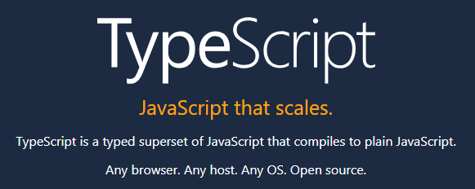

Slide 40
